Slide 1

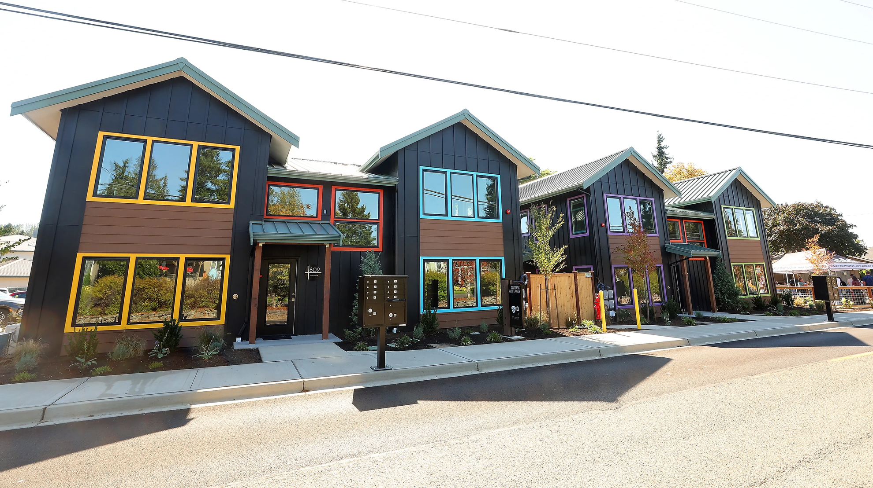

HOUSING AFFORDABILITY
Understanding Costs. Exploring Tools. Shaping Poulsbo’s Housing Future.
February 4, 2026 | Workshop 2

Slide 2



FOUR PART WORKSHOP SERIES
WORKSHOP 1: UNDERSTANDING COST DRIVERS (JANUARY 7)
WORKSHOP 2: INCENTIVES AND PROGRAMS (FEBRUARY 4)
WORKSHOP 3: IMPLEMENTATION AND TRADE-OFFS (FEBRUARY 18)
WORKSHOP 4: POLICY DIRECTION AND NEXT STEPS
(MARCH 4)
Creating a common understanding to guide future decisions.

Slide 3
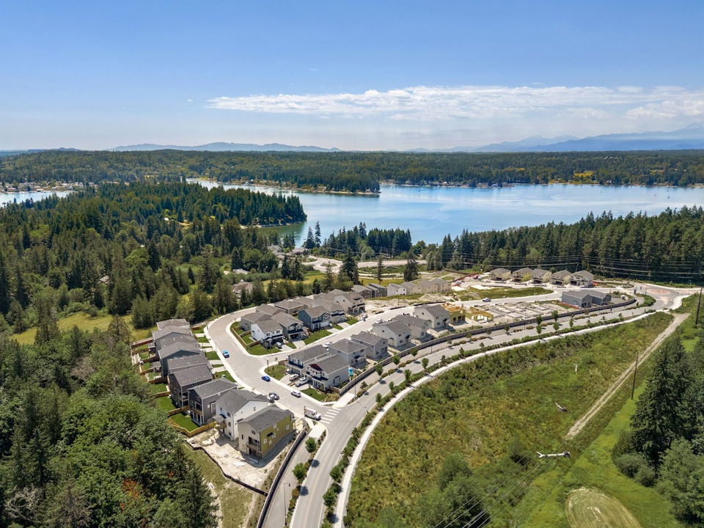

WHY ARE WE HERE?
This workshop series is designed to build a shared understanding of the factors that influence housing affordability in Poulsbo, identify the tools and incentives within the City’s control, and guide Council in setting clear policy direction for 2026 (and beyond).
Through 4 workshops, we will explore local cost drivers, evaluate feasible affordability programs, understand fiscal and administrative trade-offs, and ultimately determine which strategies the City should pursue to support a wider range of housing options for our community.

Slide 4
WORKSHOP 1 RECAP — WHAT WE LEARNED
  Workshop 1 established a shared understanding of what drives housing costs in Poulsbo and distinguished between market factors and local cost drivers.
  Market factors, such as interest rates, labor and material costs, land prices, regional demand, and lending conditions, largely determine project feasibility and are outside the City’s control.
  Local cost drivers matter at the margins, especially for projects that are close to penciling.
  City-controlled factors, including zoning standards, permitting timelines, local fees, utility charges, and infrastructure requirements, can affect risk, upfront costs, and feasibility, particularly for small, infill, and missing-middle housing.
  By clarifying what the City can and cannot influence, Workshop 1 set the foundation for evaluating programs and incentives in Workshop 2.

Slide 5
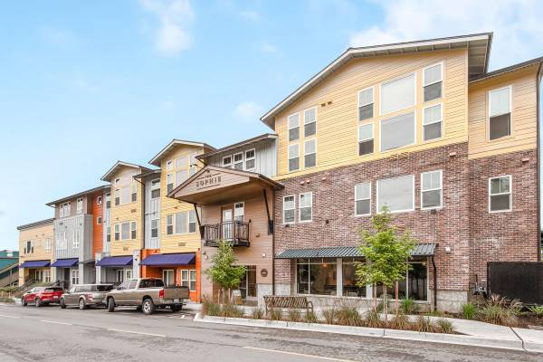
WORKSHOP 2:
PROGRAMS AND INCENTIVES
Goal: Introduce potential incentive tools and identify those most aligned with Poulsbo’s needs, capacity, and policy direction.
Key Questions:
  What outcomes are we trying to achieve with housing affordability programs?
  Which barriers do incentives need to address?
  Which households are we trying to support?

Slide 6
Tonight is not about adopting programs or making commitments. It’s about helping staff understand which tools are worth deeper, real-world analysis in the next workshop.

Slide 7
DIFFERENCE - INCENTIVES AND PROGRAMS
  Incentives are project-level tools that reduce cost, increase capacity, or improve feasibility for individual developments; they are typically faster to implement, more flexible, and have lower administrative and fiscal impacts.
  Programs are formal policy frameworks that establish ongoing systems, such as MFTE or inclusionary housing, that require ordinance adoption, dedicated administration, monitoring, and long-term oversight, and generally deliver deeper, longer-lasting affordability outcomes but with higher staff and fiscal commitments.

Slide 8
INCENTIVES
DENSITY BONUS/
VOLUNTARY INCLUSIONARY HOUSING
FEE REDUCTIONS & DEFERRALS
DIMENSIONAL FLEXIBILITY
PARKING REQUIREMENT REDUCTIONS
FRONTAGE AND
INFRASTRUCTURE FLEXIBILITY
EXPEDITED PERMITTING/
BY-RIGHT APPROVALS

Slide 9
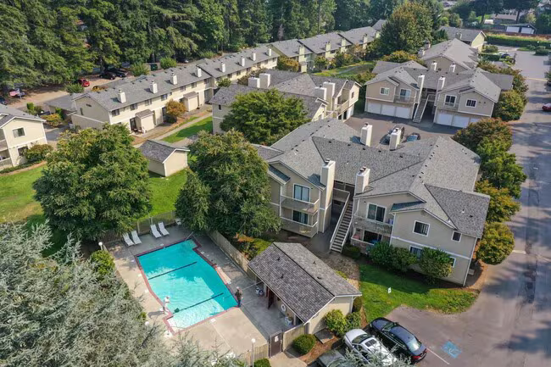
DENSITY BONUSES (Voluntary Inclusionary Housing)
What Are Density Bonuses? Allowing a project to exceed base zoning density in exchange for providing public benefits, typically affordable housing.
Typical Bonus Incentives
  +20–40% more units with an affordability requirement
Options to Consider:
  Density bonus in RM/RM-H zones for mixed-income projects
  Tiered system encouraging deeper affordability for larger bonuses
  PRD modernization to include a clear “affordable housing bonus path”
  Bonuses paired with dimensional flexibility to maximize impact

Slide 10
DENSITY BONUSES (Voluntary Inclusionary Housing)
What This Does | Allows more units on a site
Who It Helps | Lower/moderate-income households (<80%–120% AMI)
Housing Types Encouraged | Affordable Housing (Income-Restricted), Smaller Units (Naturally Affordable), Missing-Middle Housing Types
Where It Makes Sense | Citywide for Affordable, Smaller Units and, Missing-Middle Housing Types
Implementation Timeframe | Short - 2026
Staff Effort | Low-Moderate

Slide 11
DENSITY BONUS
Trade-Offs:
  Infrastructure Capacity: Additional units may increase demand on streets, utilities, parks, stormwater facilities, requiring coordination with capital planning.
  Neighborhood Perception: Increased unit count can raise concerns about scale, character, and compatibility, especially in transition areas.
  Feasibility Balance: Bonuses must be large enough to offset affordability requirements or costs—too small results in no uptake; too large can strain services.
  Equity and Location: Applying bonuses citywide may produce uneven impacts; targeting them to centers and corridors can better align growth with services.
  Administrative Complexity: Bonus programs require clear standards and monitoring to ensure promised public benefits (affordable units, design features) are delivered.

Slide 12
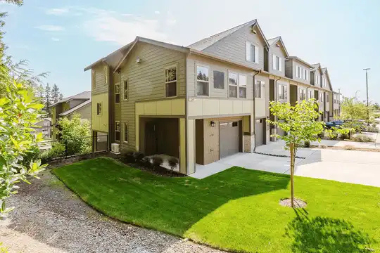
DIMENSIONAL AND DESIGN FLEXIBILITY
Adjustments to zoning and development standards that allow housing to be built more efficiently without increasing public cost. These tools focus on how buildings fit on a site, rather than how many units are allowed.
Options to Consider:
  Reduced setbacks for missing-middle housing types
  Flexible lot standards for townhomes and cottage clusters
  Higher lot coverage allowances may increase stormwater impacts and associated costs
  Reduced building separation for may increase fire protection/sprinkler requirements
  Consolidated or reduced open space requirements for small sites
  By-right dimensional standards tied to objective design rules
Common standards addressed include:
Setbacks
Lot size and lot width
Lot coverage
Building footprint and orientation
Open space and landscaping requirements
Building separation and modulation requirements

Slide 13
DIMENSIONAL AND DESIGN FLEXIBILITY
What This Does | Use of land more efficiently
Who It Helps | Lower/moderate-income households (<80%–120% AMI)
Housing Types Encouraged | Duplexes, triplexes, courtyard housing, cottage housing
Where It Makes Sense | Citywide for Affordable, Smaller Units and, Missing-Middle Housing Types
Implementation Timeframe | Short - 2026
Staff Effort | Low

Slide 14
DIMENSIONAL AND DESIGN FLEXIBILITY
Trade-Offs:
  Neighborhood Fit: Reduced setbacks or increased lot coverage can raise concerns about building scale, privacy, and compatibility if not paired with clear design standards.
  Design Quality: Simplifying dimensional standards must be balanced with maintaining quality architecture, livability, and streetscape character.
  Cumulative Impacts: Small dimensional adjustments across many sites can change neighborhood form over time, even if individual projects seem modest.
  Public Understanding: Flexibility can be misunderstood as “more density,” requiring clear communication that these tools improve feasibility without changing zoning intensity.

Slide 15
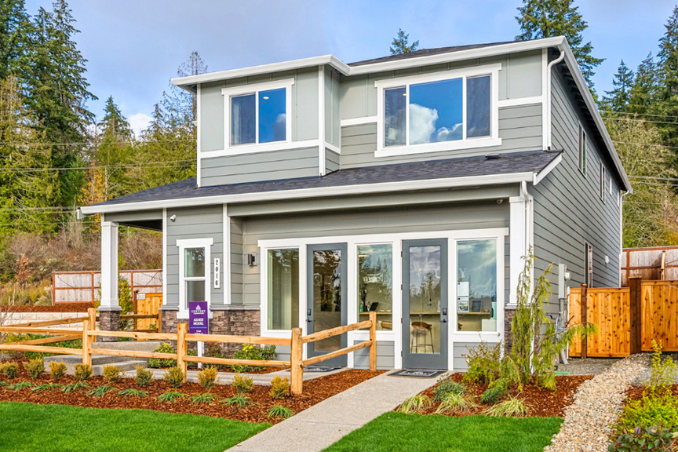
PARKING REQUIREMENT REDUCTIONS
Parking requirement reductions are policies that adjust or lower minimum off-street parking requirements so development provides parking that better matches actual demand, rather than a fixed standard, helping improve site efficiency and project feasibility.
Options to Consider:
  Lower minimum parking ratios for multifamily and missing-middle housing
  Eliminate parking minimums in specific areas, near transit.
  Reduce parking requirements for small units, studios, or affordable housing.
  Count on-street parking toward parking requirements where appropriate.
  Provide administrative flexibility for infill sites with physical constraints.
  Pair reductions with design standards (bike parking, ADA spaces, guest parking).
Typical Cost of Parking
Surface Parking: $5,000–$15,000 per stall
Structured Parking: $25,000–$50,000 per stall
Underground Parking: $50,000–$80,000+ per stall

Slide 16
PARKING REQUIREMENT REDUCTIONS
What This Does | Requires fewer parking spaces
Who It Helps | Renters and workforce households (60–120% AMI)
Housing Types Encouraged | ADUs, duplexes, triplexes, townhomes, multifamily/mixed-use
Where It Makes Sense | Near transit corridors (SR 305 and Viking)
Implementation Timeframe | Short-Mid – 2026-2027
Staff Effort | Low-Moderate

Slide 17
PARKING REQUIREMENT REDUCTIONS
Trade-Offs:
  Spillover Risk: Reduced on-site parking can raise concerns about overflow parking on nearby streets, even where demand is lower than assumed.
  Context Sensitivity: Parking needs vary by location, housing type, and household size; a one-size-fits-all reduction may not work everywhere.
  Market Acceptance: Lenders or buyers may be cautious about projects with less parking, particularly in auto-oriented areas.
  Equity Considerations: Reduced parking can benefit households without cars but may disadvantage those who rely on vehicles if alternatives are limited.
  Public Communication: Parking reductions are often misunderstood as eliminating parking entirely, requiring clear explanation that parking is being right-sized, not removed.

Slide 18
FEE REDUCTIONS & DEFERRALS
Fee reductions & deferrals are policies that lower or delay required development fees, such as impact fees, utility connection charges, or permit fees, to reduce upfront project costs and improve housing feasibility, particularly for infill, missing-middle, or affordable housing projects.
Options to Consider:
  Deferral of fees until Certificate of Occupancy (rather than permit issuance) to reduce upfront financing and carrying costs.
  Targeted fee reductions for specific housing types.
  Tiered fee schedules based on unit size, unit count, or affordability level ((where not already required by code) rather than a flat rate.
  Partial fee waivers tied to public benefits (income-restricted units).
  Fee caps for small projects where fees are disproportionate to project scale.
  Geographic targeting of fee reductions.
  Time-limited or pilot programs to test effectiveness without long-term revenue commitments.
Fees can be:
Reduced (partial or full)
Deferred (paid at Certificate of Occupancy instead of at issuance)
Credited (public improvements in lieu of fees)

Slide 19
FEE REDUCTIONS & DEFERRALS
What This Does | Lowers or delays city fees to reduce upfront costs
Who It Helps | Lower/moderate-income households (<80%–120% AMI)
Housing Types Encouraged | ADUs, small multifamily, missing-middle, entry-level ownership
Where It Makes Sense | Citywide for Affordable, Smaller Units and, Missing-Middle Housing Types
Implementation Timeframe | Mid - 2027
Staff Effort | High

Slide 20
FEE REDUCTIONS & DEFERRALS
Trade-Offs:
  Revenue Timing and Availability: Deferring or reducing fees can delay or reduce funding for parks, transportation, and utilities, requiring careful coordination with capital planning.
  Equity and Proportionality: Reductions must be structured so projects still pay their fair share for impacts, avoiding perceptions of preferential treatment.
  Targeting Effectiveness: Broad fee reductions may dilute impact; targeted reductions for infill, missing-middle, or affordable housing are more effective but require clear eligibility criteria.
  Administrative Tracking: Deferrals require systems to track payments through Certificate of Occupancy and ensure fees are ultimately collected.
  Cumulative Impact: While individual reductions may be modest, multiple reductions layered together can significantly affect long-term revenue if not monitored.

Slide 21
EXPEDITED PERMITTING & BY-RIGHT APPROVALS
Tools that shorten development review timelines and increase certainty by prioritizing project review, reducing discretionary steps, pre-clearing certain housing types or locations for streamlined approval, setting guaranteed review windows.
Expedited review = faster timeline
By-right approval = simpler process with fewer subjective steps
Options to Consider:
Expedited Review
  Priority processing for income-restricted or missing-middle housing
  Guaranteed land use review in no more than 45 days
  Guaranteed building permit review for qualifying projects
  Concurrent review for land use + engineering
By-Right Approvals
  Cottage clusters, multiplexes, and townhomes as by-right where zoning supports them
  By-right multifamily in C-1/C-2/C-3 with objective standards
  Pre-approved infill plans to shorten design review

Slide 22
EXPEDITED PERMITTING & BY-RIGHT APPROVALS
What This Does | Shortens review timelines, provides clear rules so housing can be approved faster
Who It Helps | All households
Housing Types Encouraged | Small and mid-scale projects
Where It Makes Sense | Citywide
Implementation Timeframe | Mid - 2027
Staff Effort | High

Slide 23
EXPEDITED PERMITTING & BY-RIGHT APPROVALS
Trade-Offs:
  Staff Capacity and Workload: Faster review timelines can strain staff resources and may require phasing or eligibility limits.
  Reduced Discretionary Review: By-right approvals limit case-by-case judgment, which can raise concerns about flexibility or site-specific issues if standards are not well drafted.
  Upfront Code Clarity Required: Expedited processes rely on clear, objective standards; poorly defined codes can lead to disputes or inconsistent outcomes.
  Equity and Expectations: Offering faster processing to certain projects may be perceived as preferential unless eligibility criteria are transparent and consistent.
  Quality Control: Compressed timelines require strong internal coordination to ensure technical review, safety, and compliance are not compromised.

Slide 24
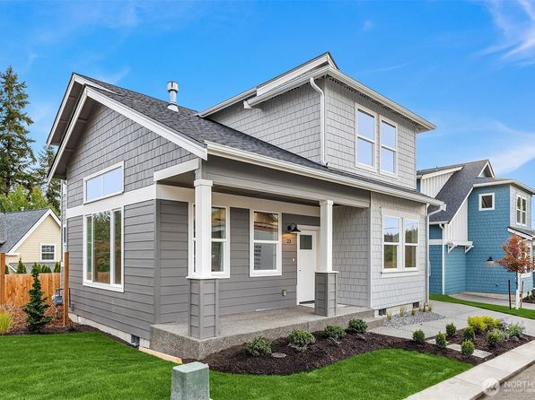
FRONTAGE & INFRASTRUCTURE FLEXIBILITY
Adjustments to required off-site and on-site public improvements so that infrastructure obligations are proportional to the scale and impact of a housing project. This flexibility focuses on how and when infrastructure is built, not eliminating it, but right-sizing it to support housing feasibility while maintaining public safety and long-term system goals.
Options to Consider
  Proportional frontage standards tied to unit count or trip generation
  Alternative sidewalk/path standards for small sites (where ADA compliance can still be met)
  Stormwater flexibility using LID for infill projects (consistent with the Ecology Stormwater Manual)
  Utility connection deferrals where appropriate (without eliminating required connections)
  Reduced open space requirements for small sites
  Open space credits for proximity to public parks
  Clear administrative criteria for when flexibility applies

Slide 25
FRONTAGE & INFRASTRUCTURE FLEXIBILITY
What This Does | Flexible frontage improvement requirements
Who It Helps | Lower/moderate-income households (<80%–120% AMI)
Housing Types Encouraged | Infill single-family, duplexes, townhomes, small multi-family
Where It Makes Sense | Citywide for Affordable, Smaller Units and, Missing-Middle Housing Types
Implementation Timeframe | Long - 2029
Staff Effort | High

Slide 26
FRONTAGE & INFRASTRUCTURE FLEXIBILITY
Trade-Offs:
  Timing of Infrastructure Delivery: Deferring or scaling improvements can shift construction to a later City-led project, requiring careful capital planning.
  Equity and Proportionality: Flexible requirements must still ensure projects pay their fair share to avoid perceptions of unequal treatment.
  Coordination Across Departments: Implementing flexibility requires close alignment between Planning, Engineering, and Public Works to maintain safety and system integrity.
  Interim Conditions: Partial or interim improvements must be designed so they do not create safety issues or conflict with ADA, fire access, or future full build-out.
  Public Perception: Reduced or alternative frontage improvements can be misunderstood as lowering standards, requiring clear communication about long-term plans and outcomes.

Slide 27



Slide 28
PROGRAMS
MULTI-FAMILY TAX EXEMPTION (MFTE)
VOLUNTARY INCLUSIONARY HOUSING
PUBLIC-PRIVATE HOUSING PARTNERSHIPS
AFFORDABLE HOUSING FEE-IN-LIEU
MANDATORY INCLUSIONARY ZONING
LAND BANKING / LAND DONATION PROGRAMS
GRANT PARTNERSHIPS
PRESERVATION / ACQUISITION PROGRAMS
LOCAL HOUSING FUND

Slide 29

MULTI-FAMILY TAX EXEMPTION (MFTE)
MFTE is a state-authorized property tax exemption program (RCW 84.14) that allows cities and counties to exempt the residential improvements of qualifying multifamily projects for a set period.
Options to Consider:
  Program term options (8, 12 , or 20-year)
  Affordability targets (60% AMI, 80% AMI, or a mix)
  Apply MFTE citywide or limit it to specific areas.
  Minimum project size (e.g., 10+ or 20+ units).
  Require a mix of unit sizes to support families, seniors, and workforce households.
  Allow MFTE to be combined with density bonuses, or parking reduction to increase effectiveness.
  Monitoring & administration to manage income certification, annual reporting, and compliance.
  Adopt as a time-limited program with periodic review to assess fiscal impacts and outcomes.
MFTE is a widely used tool with over 50 Washington communities participating.

Slide 30
MULTI-FAMILY TAX EXEMPTION (MFTE)
What This Does | Temporarily reduces property taxes in exchange for affordable rents
Who It Helps | Renters and workforce households (60–120% AMI)
Housing Types Encouraged | Multifamily rental housing
Where It Makes Sense | C-2/Viking, C-3/SR 305, C-4/College Marketplace
Implementation Timeframe | Mid - 2027
Staff Effort | High

Slide 31
MULTI-FAMILY TAX EXEMPTION (MFTE)
8-Year Exemption
  No affordability requirement
  Incentivizes general multi-family supply in targeted areas
12-Year Exemption
  Requires 20% affordable units, income ≤80% of AMI
  Mixed-income buildings
20-Year Exemption
  Rental properties not eligible (2022 change), homeownership with permanent affordability req’d
  Be sold to households earning ≤80% of AMI
  Have resale price and income restrictions enforced for at least 20 years
  Used in partnerships (nonprofit or housing authority)

Slide 32
MULTI-FAMILY TAX EXEMPTION (MFTE)
Trade-Offs:
  Tax Shift: Exempting building value shifts part of the burden to other properties during the MFTE term.
  Administrative Oversight: The program requires ongoing income verification, rent monitoring, and annual reporting for the life of the exemption.
  Targeting Effectiveness: If applied too broadly, MFTE may subsidize projects that would have been built without the incentive; if too narrow, participation may be limited.
  Market Sensitivity: MFTE effectiveness varies with market conditions, during downturns it may not be sufficient on its own to make projects feasible.

Slide 33
MULTI-FAMILY TAX EXEMPTION (MFTE)
Tax Shift Example:
A new apartment building is constructed and added to the tax base.
This allows taxing districts to increase the total amount of property tax they can collect in future years.
The building later receives a Multi-Family Tax Exemption, making the building value tax-exempt.
The total tax amount allowed to be collected does not go down when the exemption starts.
Because the exempt building no longer pays property taxes, other taxable properties make up the difference.
This shifting of tax burden to other properties is called a tax shift.

Slide 34

GRANT PARTNERSHIPS
Tools that allow the City to leverage state, federal, and regional funding, often in partnership with housing authorities, nonprofits, or other jurisdictions, to reduce infrastructure or development costs and support affordable housing.
Options to Consider:
  Target specific grant programs that align with Poulsbo’s housing and infrastructure priorities.
  Use local funds strategically as match to strengthen applications.
  Partner with Housing Kitsap or nonprofits to leverage experience, capacity, and eligibility.
  Focus on a small number of high-impact projects rather than pursuing many grants at once.
  Pilot a grant-first approach for priority sites or housing types to test staff capacity and ROI.
Why Grant Partnerships Matter
Fill partial financing gaps for affordable or mixed-income housing (often in combination with local funds or incentives)
Offset infrastructure costs (water, sewer, storm, frontage)
Reduce fee burden for projects serving low- or moderate-income households
Expand the feasibility of public/private developments

Slide 35
GRANT PARTNERSHIPS
What This Does | Uses state/federal grants to reduce project costs
Who It Helps | Very low-income households (<60% AMI)
Housing Types Encouraged | Multifamily affordable housing
Where It Makes Sense | City-owned and redevelopment sites
Implementation Timeframe | Mid - 2027
Staff Effort | High

Slide 36
GRANT PARTNERSHIPS
Trade-Offs:
  Staff Capacity and Workload: Grant writing, coordination, and reporting can be time-intensive and may strain limited staff resources.
  Uncertain Outcomes: Grant funding is competitive and not guaranteed, even with strong applications.
  Timing Constraints: Grant cycles and award schedules can delay project delivery compared to local tools.
  Match Requirements: Many grants require local matching funds, which may compete with other City priorities.
  Compliance Obligations: State and federal grants often come with long-term reporting, monitoring, and regulatory requirements.

Slide 37



Slide 38


Slide 39
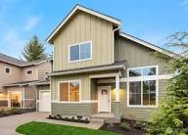
MANDATORY INCLUSIONARY HOUSING
A regulatory approach that requires certain new residential developments to include income-restricted affordable housing units or, in limited cases, pay a fee-in-lieu into a local housing fund. Unlike voluntary programs, participation is not optional once a project meets the applicability threshold.
Options to Consider:
  Can the local market support mandatory requirements without reducing housing production?
  What minimum project size should trigger the requirement?
  Which AMI targets best meet local needs?
  Should it apply citywide or only in targeted areas?
  What incentives are needed to keep projects viable?

Slide 40
MANDATORY INCLUSIONARY HOUSING
What This Does | Requires affordable units
Who It Helps | Lower-income households (<80% AMI)
Housing Types Encouraged | Multifamily
Where It Makes Sense | TBD
Implementation Timeframe | Mid - 2027-2028
Staff Effort | High

Slide 41
MANDATORY INCLUSIONARY HOUSING
Trade-Offs:
  Feasibility Risk: If requirements are not well-calibrated, mandatory set-asides can reduce housing production or discourage development.
  Market Sensitivity: Mandatory programs work best in strong markets; in moderate markets they may push development to neighboring jurisdictions.
  Administrative Burden: Requires long-term monitoring, enforcement, and management of affordability covenants.
  Project Scale Impacts: Smaller projects may be disproportionately affected unless thresholds are carefully set.
  Need for Offsets: Often requires pairing with incentives (density, parking, fee reductions) to maintain project feasibility.

Slide 42
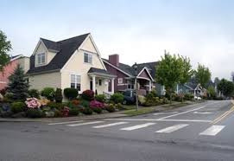
AFFORDABLE HOUSING FEE-IN-LIEU
A payment option that allows a developer to contribute funds instead of providing on-site affordable units when participating in a voluntary incentive program (e.g., density bonuses, inclusionary housing).
Options to Consider:
  Limit eligibility to small or constrained projects; require on-site units for larger developments.
  Set fee levels per unit or per square foot, calibrated to local housing costs and realistic construction costs.
  Tie fees to AMI depth, with higher fees replacing deeper affordability.
  Deposit revenues into a dedicated Local Housing Fund with clear use priorities.
  Review and adjust fees periodically to reflect market conditions.

Slide 43
AFFORDABLE HOUSING FEE-IN-LIEU
What This Does | Collects funds for affordable housing instead of on-site units
Who It Helps | Lower-income households (<80% AMI)
Housing Types Encouraged | Affordable rental or ownership projects
Where It Makes Sense | Citywide (strategic investment)
Implementation Timeframe | Mid - 2027-2028
Staff Effort | Moderate

Slide 44
AFFORDABLE HOUSING FEE-IN-LIEU
Trade-Offs:
  On-site Affordability vs. Pooled Impact: Allowing fees instead of units can reduce mixed-income integration in individual projects, even while supporting affordability elsewhere.
  Revenue Uncertainty: Fee-in-lieu revenue depends on development activity and may fluctuate year to year, making funding levels less predictable.
  Fee Calibration Risk: If fees are set too low, they may not meaningfully support affordable housing; if too high, they may discourage development.
  Timing of Housing Delivery: Affordable units funded through fees are often delivered later than on-site units, delaying affordability outcomes.
  Administrative Accountability: Requires clear governance, tracking, and reporting to ensure funds are used transparently and for intended housing purposes.

Slide 45
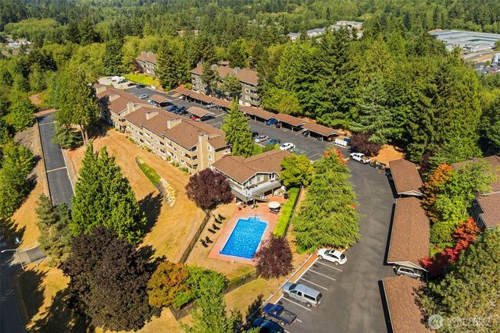
LOCAL HOUSING FUND
A dedicated City-managed fund used exclusively to support housing affordability. Funds are pooled from multiple sources and deployed strategically to close financing gaps, preserve existing affordable housing, and leverage external grants.
Options to Consider:
  Identify which revenues will capitalize the fund (fee-in-lieu, grants, General Fund contributions).
  Decide whether to focus on production, preservation, land acquisition, or grant match—or a mix.
  Determine who can access funds (City projects, Housing Kitsap, nonprofits, PPPs).
  Target investments to specific neighborhoods, centers, or corridors—or allow citywide use.
  Establish clear oversight, spending criteria, and regular Council reporting.

Slide 46
LOCAL HOUSING FUND
What This Does | Implement recommendations of ad-hoc committee
Who It Helps | Lower-income households (<80% AMI)
Housing Types Encouraged | Funds affordable rental or ownership projects
Where It Makes Sense | Citywide, priority locations
Implementation Timeframe | Short - already exists
Staff Effort | Low-Moderate

Slide 47
LOCAL HOUSING FUND
Trade-Offs:
  Revenue Variability: Funding levels depend on development activity and other sources, making annual revenues unpredictable.
  Time to Impact: Funds often need to accumulate over time before they can support a housing project.
  Administrative Oversight: Requires ongoing management, reporting, and clear governance to ensure transparency and effectiveness.
  Limited Standalone Impact: A local housing fund typically cannot produce housing on its own and must be paired with other tools or grants.
  Opportunity Cost: Using local funds for housing may limit their availability for other City priorities.

Slide 48

LAND BANKING / LAND DONATION PROGRAMS
Tools that allow the City to acquire, hold, or receive land for the purpose of supporting future affordable or mixed-income housing. The City controls when and how the land is developed, helping ensure long-term public benefit.
Options to Consider:
  Identify priority locations based on access to services, transit, jobs, etc.
  What role would the City play, direct developer or landowner issuing an RFP to a private or nonprofit partner?
  Use purchases, donations, or transfers of surplus public land, with clear cost and timing expectations.
  Will land be sold, ground-leased, or transferred to a nonprofit?
  Clear expectations for income levels, housing types, and duration of affordability.
  Partner to manage development, financing, and long-term stewardship.
Land banking = proactive acquisition and holding of land
Land donation = voluntary transfer of land (or partial interest) for housing purposes
Land can later be conveyed via sale, long-term lease, or partnership with affordability requirements

Slide 49
LAND BANKING / LAND DONATION PROGRAMS
What This Does | Secures land now for future housing
Who It Helps | Based on Council direction
Housing Types Encouraged | Rental and ownership
Where It Makes Sense | Citywide, priority locations
Implementation Timeframe | Mid – 2027-2028
Staff Effort | Moderate

Slide 50
LAND BANKING / LAND DONATION PROGRAMS
Trade-Offs:
  Upfront Funding Needs: Acquiring land requires early investment, often before housing funding or partners are secured.
  Long Timelines: Land may be held for years before development occurs, delaying visible housing outcomes.
  Holding Costs: The City may incur ongoing costs for maintenance, insurance, or management while land is held.
  Market Risk: Changes in market conditions or priorities could affect when and how land is ultimately developed.
  Capacity & Governance: Successful land banking requires clear policies, active management, and strong development partners to avoid underutilized sites.

Slide 51
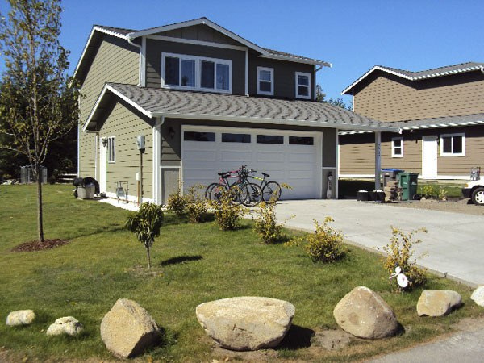
PRESERVATION / ACQUISITION PROGRAMS
Programs that allow the City (often with nonprofit or housing authority partners) to acquire existing housing, or provide funding to do so, in order to preserve affordability, prevent displacement, and stabilize rents. These programs focus on Naturally Occurring Affordable Housing (NOAH): housing that is affordable today without formal income restrictions, but vulnerable to rent increases or redevelopment.
Options to Consider:
  Use the Local Housing Fund for preservation acquisitions.
  Partner with Housing Kitsap for rapid response purchases.
  Prioritize properties near centers, corridors, or planned investment
  Focus on small multifamily and mobile home parks.
  Combine preservation with modest rehabilitation funding.
  Track inventory to identify early risk.

Slide 52
PRESERVATION / ACQUISITION PROGRAMS
What This Does | Prevents loss of existing affordable housing
Who It Helps | Lower-income renters (<80% AMI)
Housing Types Encouraged | Existing multifamily housing
Where It Makes Sense | Older multifamily areas
Implementation Timeframe | Long - 2028
Staff Effort | Moderate

Slide 53
PRESERVATION / ACQUISITION PROGRAMS
Trade-Offs:
  Upfront Funding Needs: Acquisitions require immediate capital, often before long-term funding is secured.
  Property Condition Risk: Older buildings may need substantial rehabilitation, increasing total project cost.
  Competitive Market Pressure: At-risk properties may be sold quickly, limiting the City’s ability to respond.
  Long-Term Management: Preserved units require ongoing oversight, affordability monitoring, and asset management.
  Less Visible Impact: Preservation stabilizes existing housing but may be less noticeable than new construction.

Slide 54
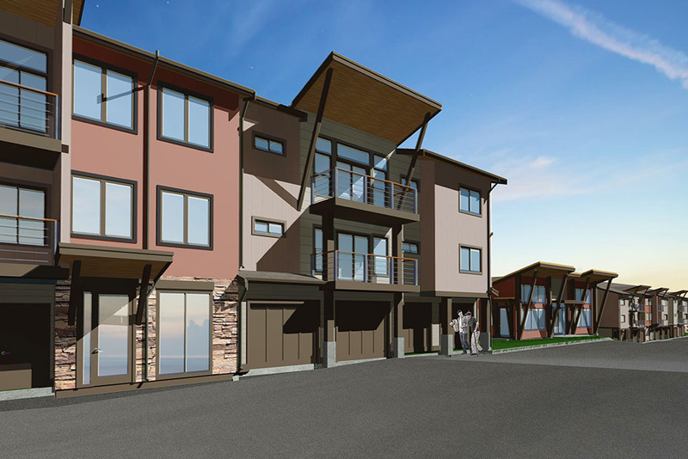
PUBLIC-PRIVATE HOUSING PARTNERSHIPS
Collaborative arrangements where the City partners with private developers, housing authorities, or nonprofit organizations to deliver housing that advances public goals, such as affordability, mixed-income development, or strategic redevelopment, while sharing risk, cost, and responsibility. The City typically contributes land, funding, regulatory certainty, or infrastructure, while private or nonprofit partners deliver development expertise and capital.
Options to Consider:
  Inventory City-owned or surplus properties
  Identify priority sites for housing partnerships
  Use long-term ground leases to retain public control
  Pair PPPs with grants, MFTE, or Local Housing Fund dollars
  Partner with Housing Kitsap or experienced nonprofit developers
  Focus on 1–2 strategic projects rather than many small ones

Slide 55
PUBLIC-PRIVATE HOUSING PARTNERSHIPS
What This Does | Uses City land and staff to support housing
Who It Helps | Lower-income households (<80% AMI)
Housing Types Encouraged | Mixed-income, multifamily
Where It Makes Sense | City-owned or strategic sites
Implementation Timeframe | Short-Medium – 2026-2027
Staff Effort | Moderate

Slide 56
PUBLIC-PRIVATE HOUSING PARTNERSHIPS
Trade-Offs:
  Complex Negotiations: Partnerships require detailed agreements, legal review, and extended coordination, increasing time and effort.
  Staff Capacity Demands: Managing partnerships and overseeing compliance can be resource-intensive for City staff.
  Risk Sharing: The City may assume financial, political, or timing risk if projects face delays or cost overruns.
  Longer Timelines: PPP projects often take longer to move from concept to construction than incentive-based approaches.
  Public Accountability: Use of public assets or funds requires transparency and careful oversight to maintain public trust.

Slide 57
OTHER
ANNEXATION
UGA SWAP

Slide 58
UGA SWAP
  What it is: Exchanging land inside the UGA for land outside the UGA to better align growth with infrastructure, environmental constraints, or development feasibility.
  What it requires:
    County-led process with coordination among the City, County, and affected jurisdictions
    Comprehensive Plan amendments and justification under GMA criteria
    Environmental review and infrastructure analysis
  Staffing & capacity:
    Very staff-intensive (long-range planning, legal, coordination with Kitsap County)
    Multi-year timeline; typically outside annual work programs
  Affordability implications:
    Can redirect growth to more feasible or less constrained land
    Benefits are indirect and long-term, not immediate
  Key reality: Long-term growth strategy, not a near-term housing production lever.

Slide 59
ANNEXATION
  What it is: Bringing land outside City limits into Poulsbo in exchange for City services, zoning, and development capacity.
  What it requires:
    Consistency with the Comprehensive Plan and Kitsap Countywide Planning Policies
    Extension of City utilities, streets, and services (often at developer cost, sometimes shared).
    Potential pre-annexation agreements outlining infrastructure, phasing, and zoning
  Staffing & capacity:
    High upfront staff time (planning, engineering, legal, finance)
    Significant interdepartmental coordination and long timelines
  Affordability implications:
    Can increase overall land supply and unit capacity
    Does not inherently produce more housing unless paired with incentives or requirements
  Key reality: Long-term growth strategy, not a near-term housing production lever.

Slide 61
KEY TAKEAWAYS - WORKSHOP 2
  A mix of incentives, not one tool alone, is needed to meaningfully support housing affordability.
  Each incentive type serves different needs (workforce, low-income, infill).
  Programs must be calibrated to market conditions so they improve feasibility without discouraging development.
  Most incentives require ongoing staff capacity for monitoring, reporting, and administration.
  Some tools have fiscal implications (tax shift, foregone revenue, reduced fees) that must be weighed alongside housing goals.
  Council direction is needed to narrow down which programs should proceed to deeper analysis in Workshop 3.

Slide 62

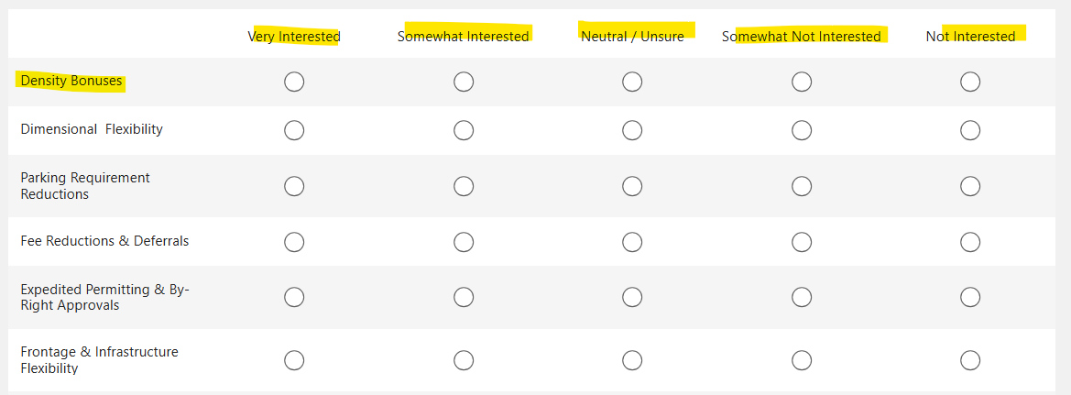
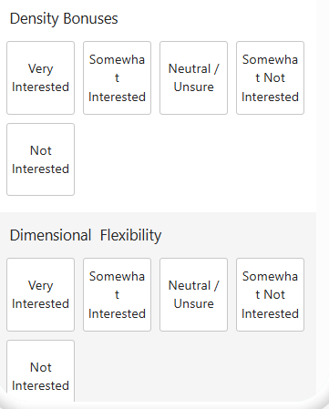
FROM TOOLS TO CHOICES
Workshop 3 is where these concepts meet real projects, real numbers, and real trade-offs
Which tools should move forward to deeper evaluation?

Slide 63
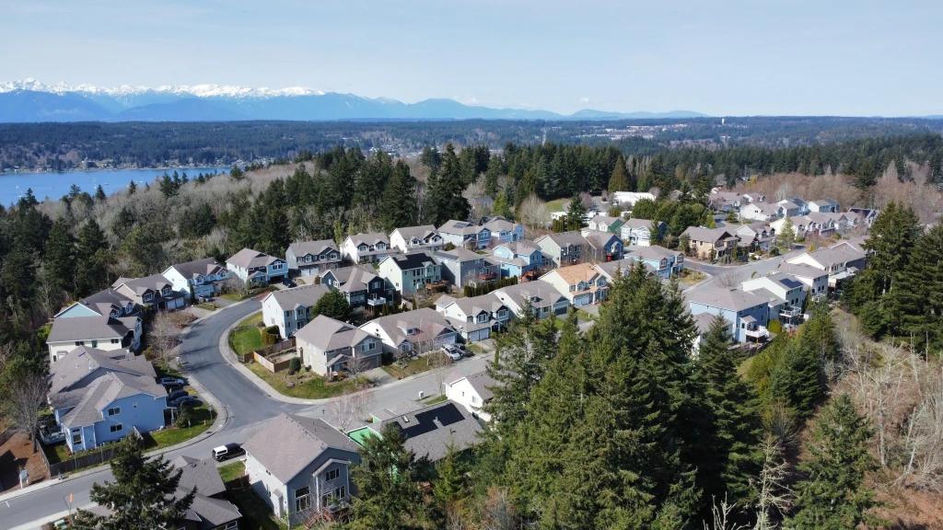
THANK YOU

